Slide 1
Human Computer Interaction
Design Perceptual Organization

Slide 2
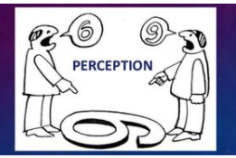
Perception
Perception is the organization, identification, and interpretation of sensory information to represent and understand the environment.
People's behavior is based on their perception of what reality is, not on reality itself.
Notes:
Stimulus = a thing or event that evokes a specific functional reaction in an organ or tissue.
Sensory Information are things that the brain collects from your senses that give you information about the world around you. The five basic senses are taste, sight, smell, hearing, and touch. Sensory information is collected from sensory receptors that are located throughout your body (such as photoreceptor cells in your eyes for vision and taste receptor cells on your tongue for taste) and then sent to the brain where it is processed. Some examples of sensory information are the smell of baking bread (smell), the feel of a wool sweater (touch), the taste of an apple (taste), a song (hearing), and a painting (sight).

Slide 3

Perception vs reality

Slide 4
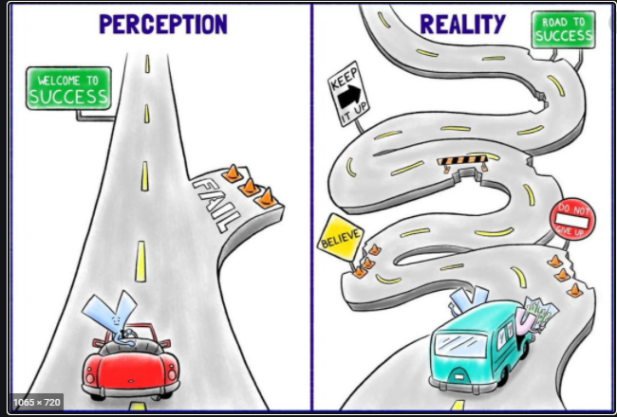

Slide 5
Perceptual process
Stimuli
Receiving stimuli (or organizing)
Selective attention (or selecting stimuli)
Perceptual organization (group stimuli into recognizable patterns)
Interpreting (assigning meaning)
Response
Notes:
Stimulus = a thing or event that evokes a specific functional reaction in an organ or tissue.

Slide 6
Perceptual process
The perceptual process is the sequence of psychological steps that a person uses to organize and interpret information from the outside world.
Objects are present in the world.
A person observes.
The person uses perception to select objects.
The person organizes the perception of objects.
The person interprets the perceptions.
The person responds.
Notes:
The selection, organization, and interpretation of perceptions can differ among different people. Therefore, when people react differently in a situation, part of their behavior can be explained by examining their perceptual process, and how their perceptions are leading to their responses

Slide 7
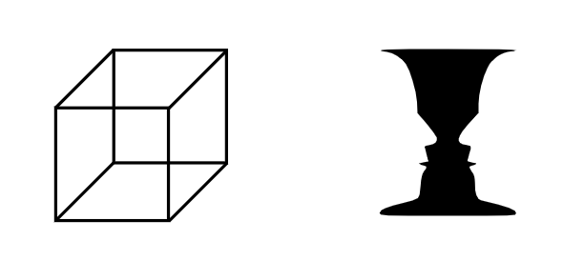
Perceptual process

Slide 8
Perceptual Selection
Size – A larger size makes it more likely an object will be selected.
Intensity – Greater intensity, in brightness, for example, also increases perceptual selection.
Contrast – When a perception stands clearly out against a background, there is a greater likelihood of selection.
Motion – A moving perception is more likely to be selected.
Repetition – Repetition increases perceptual selection.
Novelty and familiarity – Both of these increase selection. When a perception is new, it stands out in a person’s experience. When it is familiar, it is likely to be selected because of this familiarity.

Slide 9
Perceptual organization
The process by which people group stimuli into recognizable patterns
  What mental picture do you have for a wooden object with 4 legs?
  When people actually see the above wooden object having these characteristics, they are able to organize information into meaningful whole and recognize the object to be a chair.

Slide 10
Perceptual Illusions
They can be understood as reliable perceptual errors
People don’t perceive length, area, angle, brightness the way they “should”.

Slide 11
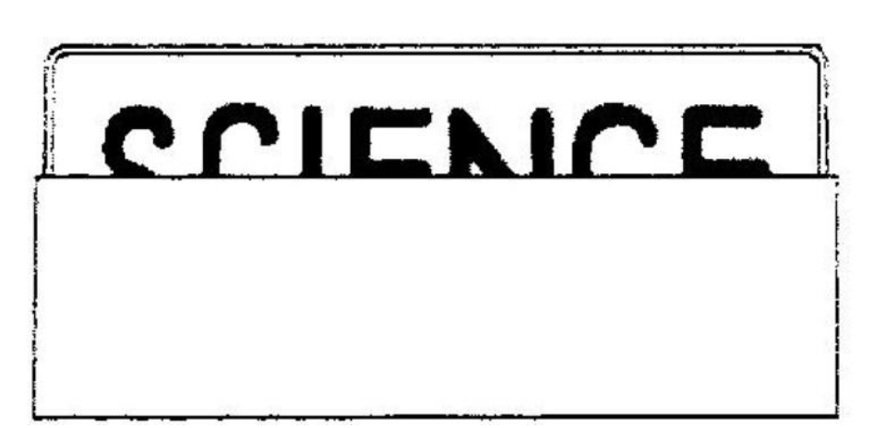
Perceptual Illusions

Slide 12
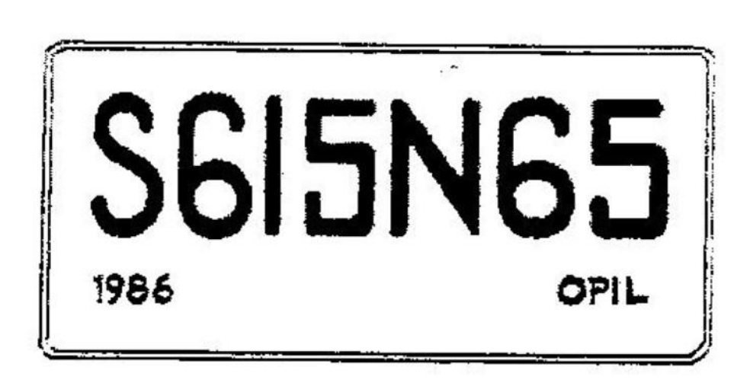
Perceptual Illusions

Slide 13
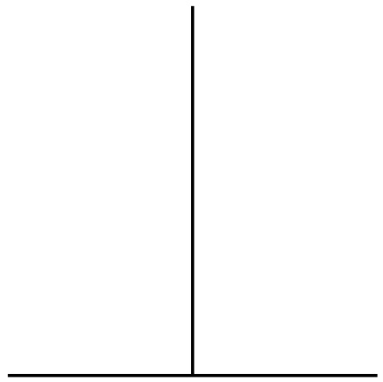
Perceptual Illusions

Slide 14
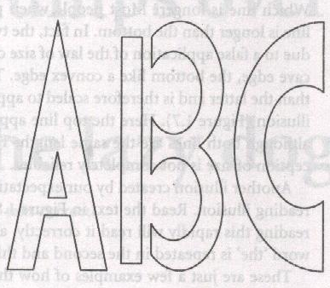
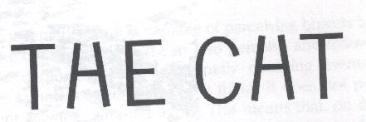
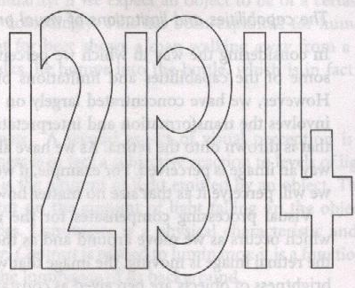
Perceptual Illusions: Contextual

Slide 15
2. Pre-Attention

Slide 16
Pre-attentive Processing
A limited set of visual properties are processed/detected very rapidly and accurately (pre-attentively i.e. without need for focusing attention) by the low level visual system.
This is important for design of graphics visualizations
  what can be perceived immediately
  what properties are good discriminators
  what can mislead viewers

Slide 17
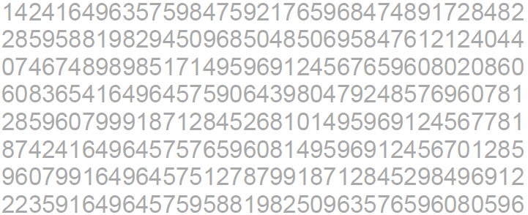
How many 3’s ?

Slide 18
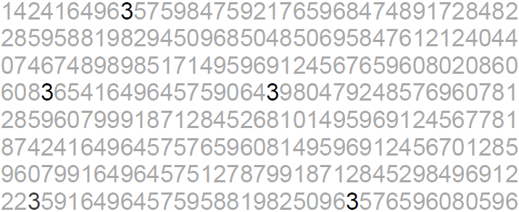
How many 3’s ?

Slide 19
Pre-attentive Processing
< 200 - 250ms qualifies as pre-attentive
  eye movements take at least 200ms
If a decision takes a fixed amount of time regardless of the number of distractors, it is considered to be preattentive.
Notes:
yet certain processing can be done very quickly, implying low-level processing in parallel

Slide 20
Pop-Out in Visual Search
2 distractors
5 distractors
10 distractors
O
V
V
V
V
V
V
O
V
V
O
V
V
V
V
V
V
V
V
V
T
T
T
T
T
T
T
L
T
L
T
T
T
T
T
T
L
T
T
T

Slide 21
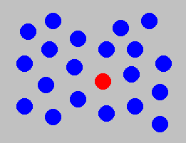
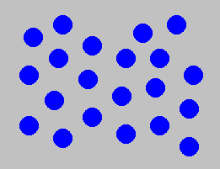
Example: Color Selection
Viewer can rapidly and accurately determine
whether the target (red circle) is present or absent.
Difference detected in color.

Slide 22
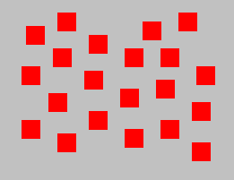
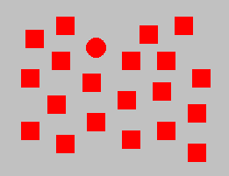
Example: Shape Selection
Viewer can rapidly and accurately determine
whether the target (red circle) is present or absent.
Difference detected in form (curvature)

Slide 23
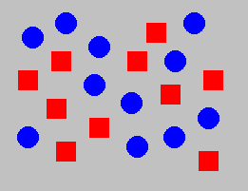
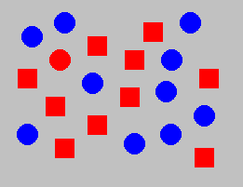
Example: Conjunction of Features
Viewer cannot rapidly and accurately determine
whether the target (red circle) is present or absent when
target has two or more features, each of which are
present in the distractors. Viewer must search sequentially.

Slide 24
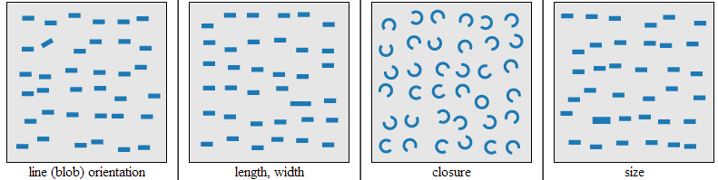
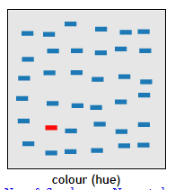
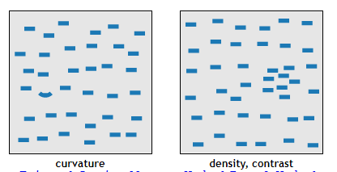
Pre-attentive features
Notes:
https://www.csc2.ncsu.edu/faculty/healey/PP/index.html

Slide 25
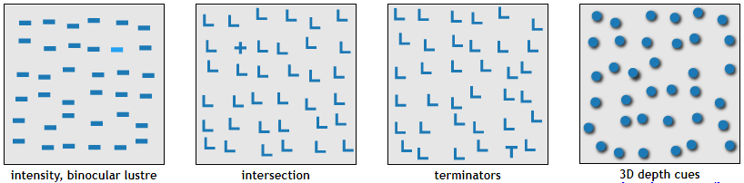
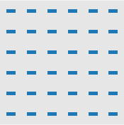
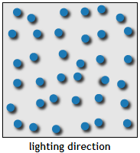
Pre-attentive features

Slide 26
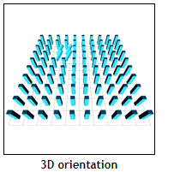
Pre-attentive features

Slide 27
Influences on Perception

Slide 28
Influences on Perception

Slide 29
Influences on Perception

Slide 30
Influences on Perception

Slide 31
Gestalt principles (laws)
Gestalt refers to shape or form in German.
They describe how the human eye perceives visual elements
In particular they tell us that complex images tend to be reduced to simpler shapes

Slide 32
Gestalt principles (laws)
The whole is other than the sum of parts
  The human eye and brain perceive a unified shape in a different way to the way they perceive the individual parts of those shapes. This global whole is a separate entity that is not necessarily formed by the sum of its parts.

Slide 33

Gestalt principles (laws)
The whole is other than the sum of parts
Notes:
In the simplest terms, gestalt theory is based on the idea that the human brain will attempt to simplify and organize complex images or designs that consist of many elements, by subconsciously arranging the parts into an organized system that creates a whole, rather than just a series of disparate elements. Our brains are built to see structure and patterns in order for us to better understand the environment that we’re living in.

Slide 34

Have you ever wondered, why or how you make this association just by looking at a fluffy, blob of gas?
Notes:
Your brain is always trying to make sense of the world by comparing previous experiences or visual patterns and connecting the dots. It has its own “weird” way of perceiving shape and form, grouping information, fill in the gaps to draw the big picture.

Slide 35
Gestalt principles (laws)
Having an understanding how your brain works will help you become a wiser designer
It can help you determine which visual elements are most effective in any given situation, so you can use them to influence perception, direct attention and cause behavioral change.

Slide 36
Gestalt principles (laws)
The implementation of Gestalt principles can greatly improve, not just the aesthetics of a design, but also its functionality and user-friendliness, and are a valuable set of ideas for any designer to learn.

Slide 37
Gestalt principles (laws)
Proximity
Symmetry
Closure
Similarity
Common fate
Continuity
Figure-ground
Connectedness
Simplicity
Past Experience
Notes:
2
2

Slide 38
Principle of Proximity
Objects that are near to each other are seen as being more related than objects that are father apart.

Slide 39
Principle of Proximity
The distance between objects effects our perception of the objects.
Are the objects grouped, or not?
Objects that are close together are perceived as being grouped.

Slide 40
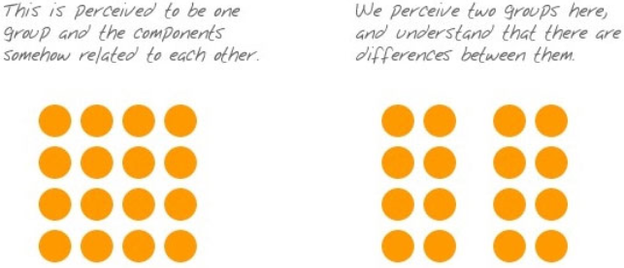
Principle of Proximity

Slide 41
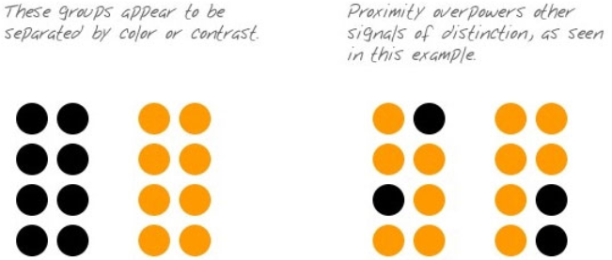
Principle of Proximity

Slide 42
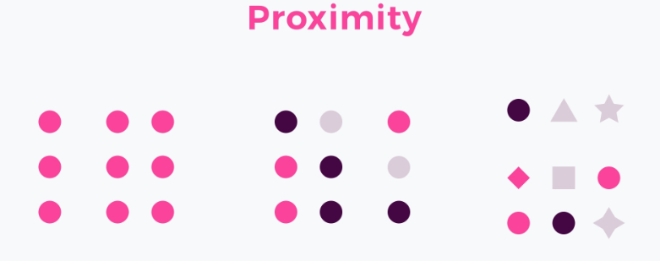

Slide 43
Proximity
Proximity may be used to group content and action controls that are related to each other.
It is also bonded with White space that plays an essential role in the principle.
It boosts the relations between elements and strengthens the designer’s intention.
In the end, users are able to scan content faster and accomplish their goals much more efficiently.

Slide 44
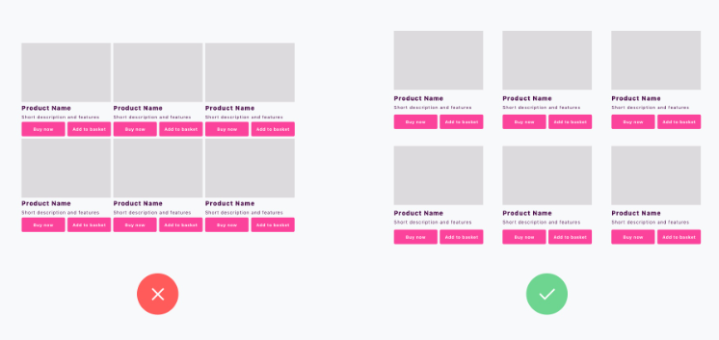

Slide 45
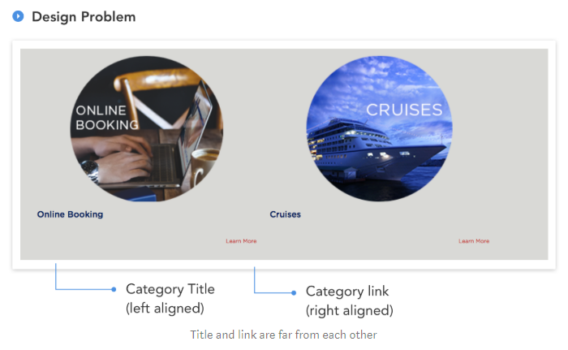

Slide 46
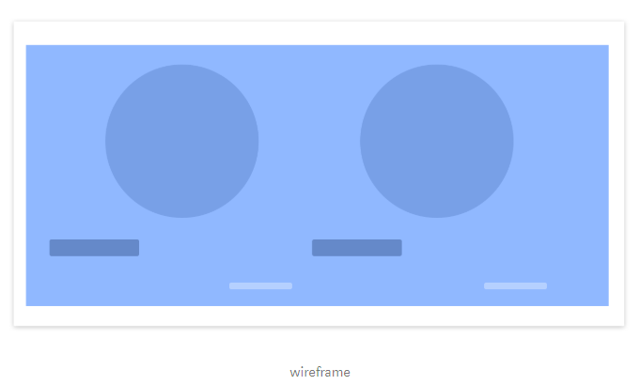

Slide 47
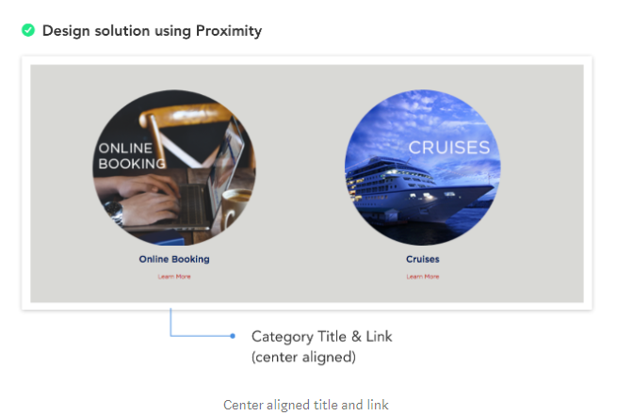

Slide 48
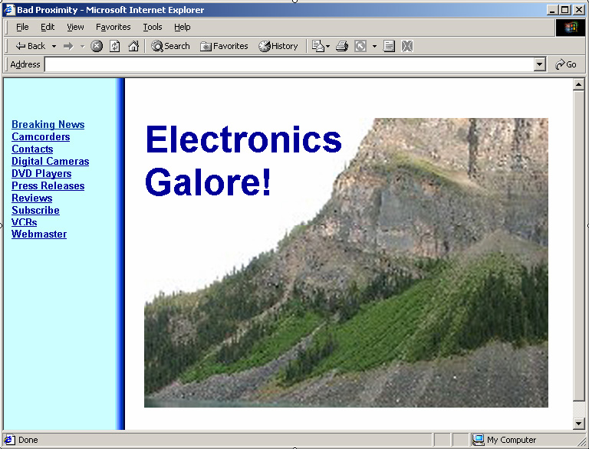

Slide 49
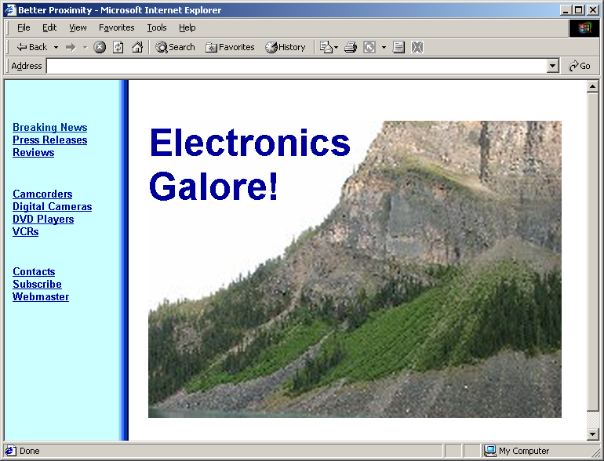

Slide 50
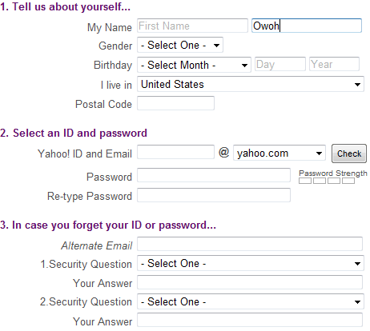

Slide 51



example

Slide 52
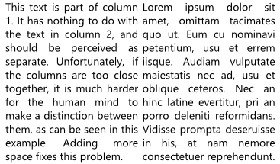
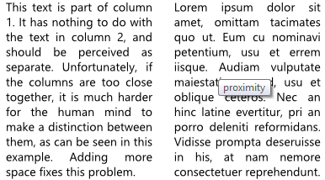
Principle of Proximity

Slide 53
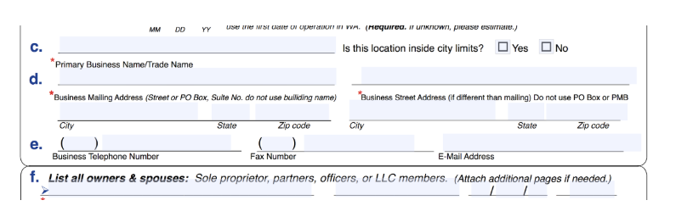
Notes:
Due to the field labels being closer to the fields under them, people would mistakenly believe that's where the information goes for "c." and "d." Yet, the information is supposed to be provided in the fields above the text labels.

Slide 54
Principle of Proximity
If your intent is that items in a user interface are to be “read” by the user as being grouped, place them in close proximity.
If items in the user interface are not intended to be “read” as being grouped, be careful to allow enough space between them.

Slide 55
Principle of Similarity
The human eye tends to build a relationship between similar elements within a design. Similarity can be achieved using basic elements such as shapes, colors, and size.

Slide 56


Slide 57
Principle of Similarity
Objects that look similar appear to be grouped
This is a good thing, when it is done intentionally.
Other than color, size and shape other factors that strengthen the similarity: shadow & texture etc.

Slide 58
When users notice similar element in the UI, they categorize them as particular patterns.
Thanks to this they quickly recognize the meaning of specific UI controls.
This is why it is so crucial for the primary buttons to look the same on every page.
In the group of “similar” elements, We tend to see objects with the similarity of colors first, then size and in the end shape.

Slide 59


Slide 60
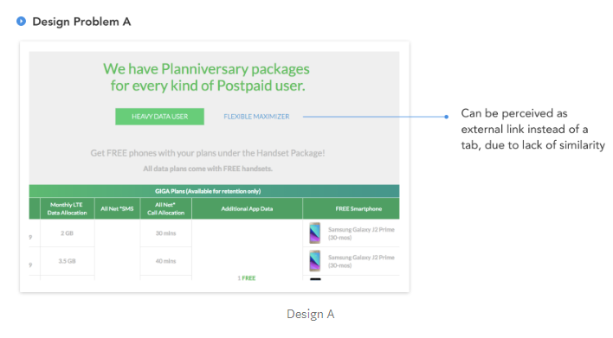

Slide 61
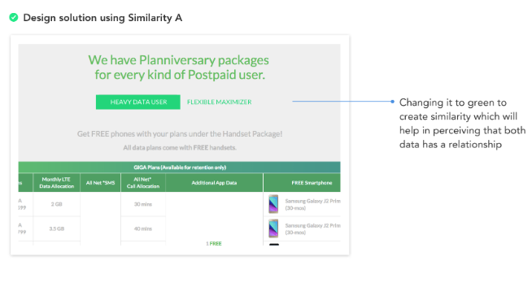

Slide 62
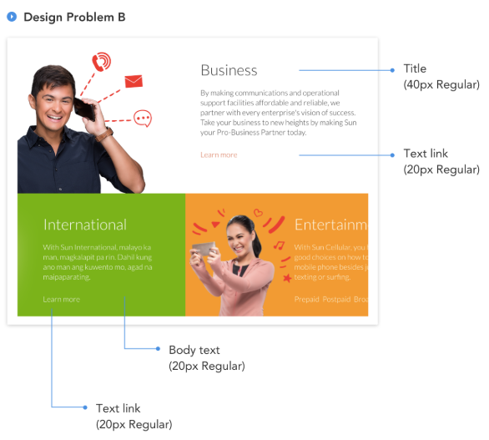

Slide 63
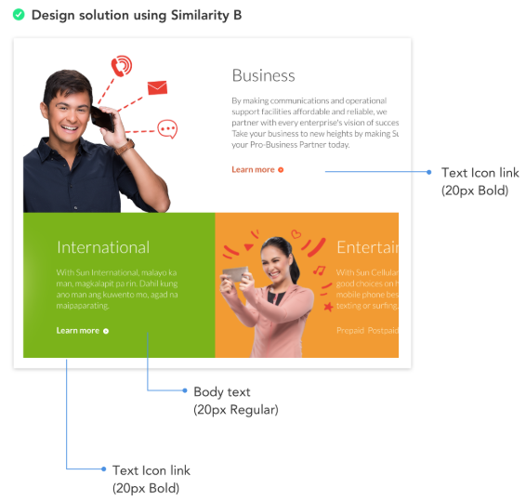

Slide 64
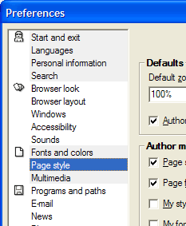
Principle of Similarity

Slide 65
Principle of Continuity
We tend to perceive figures or objects as belonging together if they appear to form a continuous pattern.
The human eye follows the paths, lines, and curves of a design, and prefers to see a continuous flow of visual elements rather than separated objects.

Slide 66
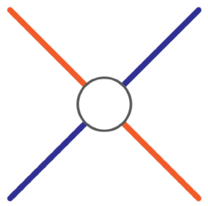
Principle of Continuity
Visual perception is based on continuous forms, not disconnected segments

Slide 67
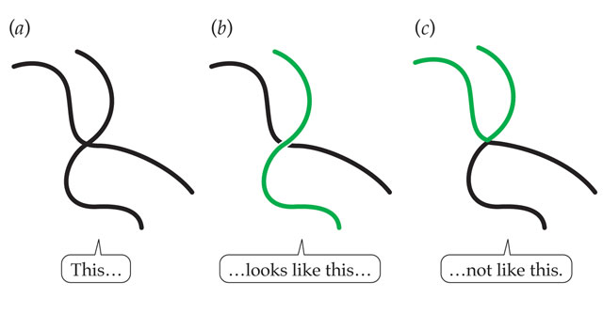
Principle of Continuity

Slide 68
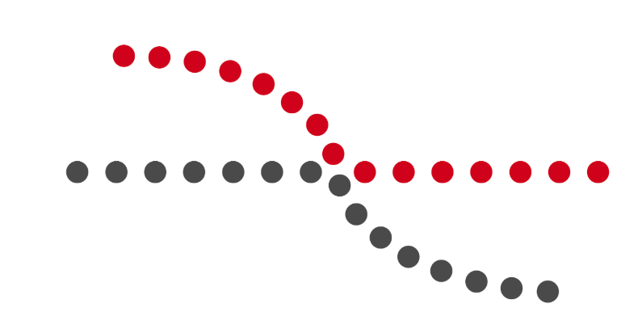
human eye will follow the smoothest path when viewing lines, regardless of how the lines were actually drawn.

Slide 69
Since the eye naturally follows a line, placing items in a series in a line will naturally draw the eye from one item to the next.
Horizontal sliders are one such example, as are related product listings on sites like Amazon.

Slide 70
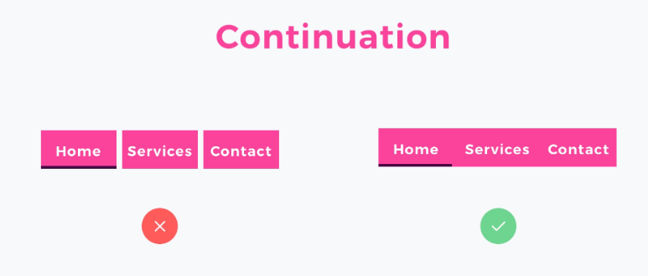

Slide 71
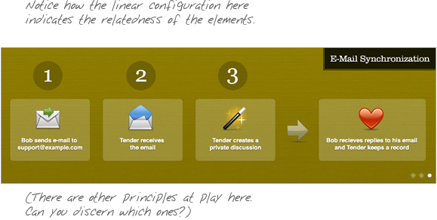
Principle of Continuity
Use of numbering
Use of arrows

Slide 72
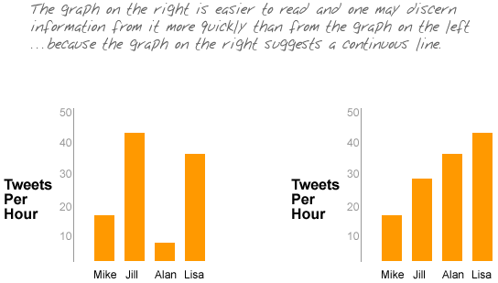
Principle of Continuity

Slide 73

Elements arranged in a straight line or a smooth curve are perceived as a group and are interpreted as being more related than elements not on the line or curve.

Slide 74
Principle of Closure
The law of Closure explains how we perceive incomplete shapes. When there is missing information in an image, the eye ignores the missing information and fills in the gaps with lines, color or patterns from the surrounding area to complete the image.
We can use this law to achieve visual effects.

Slide 75
Principle of Closure
We automatically attempt to complete “open” objects so that we perceive them as whole.
Our visual system can interpret totally blank areas as objects.
This is what graphic designers refer to as “white space”

Slide 76
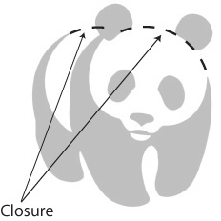
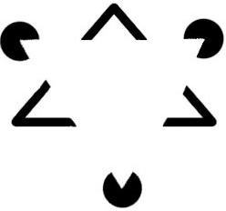

Principle of Closure

Slide 77


Slide 78

We resolve ambiguity by adding in missing data in such a way that we perceive whole objects. We are biased towards perceiving continuous forms rather than disconnected pieces.

Slide 79

Principle of Closure

Slide 80
How can this be applied?
Loading states, completion meters are great examples of this.
The law of closure was used to make the solution more understandable to the user.
The other usage of closure is negative space. We see it in logos and iconography. It makes the design more readable or even enjoyable.

Slide 81


Slide 82
Principle of Symmetry
When we look at certain objects, we see them as symmetrical shapes that form around their center.
Humans like symmetry, and find it aesthetically appealing.

Slide 83
Principle of Symmetry
The goal of our visual system: reduce complexity
We interpret data in our visual field in more than one way, but always with the goal of simplification
Organizing objects into symmetrical shapes allows for easier understanding
It’s automatic
Symmetry is the primary principle used to interpret three dimensional renderings on a two dimensional display.

Slide 84


Notes:
A typical textbook example of the law of symmetry (figure 4.B.), consists of a configuration of a number of brackets. When perceiving the configuration, we see three pairs of symmetrical brackets as opposed to 6 individual brackets, or two pairs and two singles. This happens despite what is suggested by some of the brackets immediate proximity to each other.
In the above (figure 4.A), CSC Finland's logo is perceived as an integral whole although the two constituent geometrical shapes seem to be pointing in different directions and have differing colours.

Slide 85


Slide 86

Notes:
UI Elements that are symmetrical to each other helps to scan the content and recognize patterns. Symmetry allows users to focus on what is essential. Symmetrical navigation menus tend to be perceived as more stable. The principle is excellent to use when you design galleries or banners.

Slide 87
Principle of Figure-Ground
How the human eye separates shapes from the background in a design.
Elements are perceived as either figures (distinct elements of focus) or ground (the background or landscape on which the figures rest).

Slide 88


Slide 89
Principle of Figure-Ground
There are two main factors that affect the way we perceive the figure and the ground in any given design.
Size of the figure when compared to the background
  Bigger image is ground and smaller one is figure
Contrast between the figure and the ground
  Black color for text (figure) and white color for page (ground)

Slide 90


Slide 91
Principle of Figure-Ground
Our mind separates the visual field into figure (the foreground) and ground (the background)
When objects overlap, we tend to see the smaller object as existing in the foreground and the larger object as in the background
Objects in our primary attention seem to be in the foreground, while everything else seems to fade into the background.

Slide 92


Slide 93
Principle of Figure-Ground
The relationship between figure and ground can be classified into three categories
Stable
  The figure will be clearly identifiable from the background
Reversible
  The figure and background have near-equal density. This enables the eye to flip the figure with the background. This can be used to create visual illusions.
Ambiguous
  There is a little distinction between the ground and the figure. At any point, a single element might be both figure and ground at the same time.

Slide 94

Stable

Slide 95

reversible

Slide 96

Principle of Figure-Ground - reversible

Slide 97

Principle of Figure-Ground - ambiguous

Slide 98


Slide 99


Using Principle of Figure-Ground

Slide 100

Using Principle of Figure-Ground

Slide 101
Principle of Common Fate
Visual elements moving together in the same direction simultaneously tend to be perceived as a group.
Notes:
http://www.scholarpedia.org/article/Gestalt_principles

Slide 102
Principle of Common Fate
This principal deals with motion and animated objects
All things being equal, if a group of objects moves in a similar way, they are perceived to be a related group
Common motion = common fate

Slide 103

Principle of Common Fate

Slide 104


Principle of Common Fate
when objects point in the same direction, we see them as a related group.

Slide 105
For example, in Microsoft Windows or Mac OS, if you select a number of icons and then drag-and-drop them, partially-transparent copies of all of the selected icons move together

Slide 106

Notes:
A slide-out menu, for example, exploits this principle well. In the example below, the way that sub-menu items move into visibility as distinct groupings of elements all moving in concert shows us that the grouped links are related (within each group). I’m not suggesting that this is an optimal way to construct navigation, but the principle here is clear.

Slide 107
Principle of Connectedness
The law of connectedness states that elements that are connected to each other using colors, lines, frames, or other shapes are perceived as a single unit when compared with other elements that are not linked in the same manner.

Slide 108

Principle of Connectedness

Slide 109


Slide 110

Principle of Connectedness

Slide 111


Slide 112


Slide 113


Slide 114
Principle of Simplicity (or Prägnanz)
Prägnanz is a German word that means “good figure”
The human eye likes to find simplicity and order in complex shapes
Notes:
https://www.interaction-design.org/literature/article/the-laws-of-figure-ground-praegnanz-closure-and-common-fate-gestalt-principles-3

Slide 115
Principle of Simplicity

Slide 116


Slide 118


Principle of Simplicity
Notes:
(a) This is usually perceived as five circles, not as the nine shapes in (b).
Principles of perceptual organization
Pragnanz (also called law of simplicity) - every stimulus is seen as simply as possible

Slide 119

For example, a monochrome version of the Olympic logo is seen as a series of overlapping circles rather than a collection of curved lines.

Slide 120

Principle of Simplicity

Slide 121

Principle of Simplicity

Slide 122

Principle of Simplicity

Slide 123
Principle of Past Experience
Elements tend to be grouped together if they were together often in the past experience of the observer

Slide 124

Principle of Past Experience

Slide 125
Principle of Past Experience
In print perhaps the most potent Gestalt principle is proximity:
Simply inserting larger blank spaces between words than between letters helps group together the letters correctly, and establish words.

Slide 126
Principle of Past Experience
The importance of blank spaces is demonstrated by the difficulty:
wehavewhenreadingtextnotseparatedbyblanks an dev enmor ew henbl an kspa cesap pea rinwr ongpl aces.

Slide 127

Principle of past experience

Slide 128


Slide 129
Shneiderman’s 8 Golden Rules
Strive for consistency
Enable frequent users to use shortcuts
Offer informative feedback
Design dialogs to yield closure
Offer error prevention and simple error handling
Permit easy reversal of actions
Support internal locus of control
Reduce short-term memory load
Notes:
1. Strive for consistency.
Consistent sequences of actions should be required in similar situations; identical terminology should be used in prompts, menus, and help screens; and consistent color, layout, capitalization, fonts, and so on should be employed throughout. Exceptions, such as required confirmation of the delete command or no echoing of passwords, should be comprehensible and limited in number.
2. Cater to universal usability.
Recognize the needs of diverse users and design for plasticity, facilitating transformation of content. Novice to expert differences, age ranges, disabilities, and technological diversity each enrich the spectrum of requirements that guides design. Adding features for novices, such as explanations, and features for experts, such as shortcuts and faster pacing, can enrich the interface design and improve perceived system quality.
3. Offer informative feedback.
For every user action, there should be system feedback. For frequent and minor actions, the response can be modest, whereas for infrequent and major actions, the response should be more substantial. Visual presentation of the objects of interest provides a convenient environment for showing changes explicitly.
4. Design dialogs to yield closure.
Sequences of actions should be organized into groups with a beginning, middle, and end. Informative feedback at the completion of a group of actions gives operators the satisfaction of accomplishment, a sense of relief, a signal to drop contingency plans from their minds, and an indicator to prepare for the next group of actions. For example, e-commerce web sites move users from selecting products to the checkout, ending with a clear confirmation page that completes the transaction.
5. Prevent errors.
As much as possible, design the system such that users cannot make serious errors; for example, gray out menu items that are not appropriate and do not allow alphabetic characters in numeric entry fields. If a user makes an error, the interface should detect the error and offer simple, constructive, and specific instructions for recovery. For example, users should not have to retype an entire name-address form if they enter an invalid zip code, but rather should be guided to repair only the faulty part. Erroneous actions should leave the system state unchanged, or the interface should give instructions about restoring the state.
6. Permit easy reversal of actions.
As much as possible, actions should be reversible. This feature relieves anxiety, since the user knows that errors can be undone, and encourages exploration of unfamiliar options. The units of reversibility may be a single action, a data-entry task, or a complete group of actions, such as entry of a name-address block.
7. Support internal locus of control.
Experienced users strongly desire the sense that they are in charge of the interface and that the interface responds to their actions. They don’t want surprises or changes in familiar behavior, and they are annoyed by tedious data-entry sequences, difficulty in obtaining necessary information, and inability to produce their desired result.
8. Reduce short-term memory load.
Humans’ limited capacity for information processing in short-term memory (the rule of thumb is that we can remember "seven plus or minus two chunks" of information) requires that designers avoid interfaces in which users must remember information from one screen and then use that information on another screen. It means that cell phones should not require re-entry of phone numbers, web-site locations should remain visible, multiple-page displays should be consolidated, and sufficient training time should be allotted for complex sequences of actions.
These underlying principles must be interpreted, refined, and extended for each environment. They have their limitations, but they provide a good starting point for mobile, desktop, and web designers. The principles presented in the ensuing sections focus on increasing users’ productivity by providing simplified data-entry procedures, comprehensible displays, and rapid informative feedback to increase feelings of competence, mastery, and control over the system.

Slide 130
Norman’s 7 Principles
Use both knowledge in the world and knowledge in the head.
Simplify the structure of tasks.
Make things visible: bridge the gulfs of Execution and Evaluation.
Get the mappings right.
Exploit the power of constraints, both natural and artificial.
Design for error.
When all else fails, standardize.

